Slide 1
Fence Patrol
Python with Robots Mission 5
Lesson 1 Objectives 1-2

Slide 2

Pre-Mission Warm-Up
In your Mission 5 Lesson 1 log, answer the pre-mission warm-up question:
What are some things you would like CodeBot to detect?

Slide 3
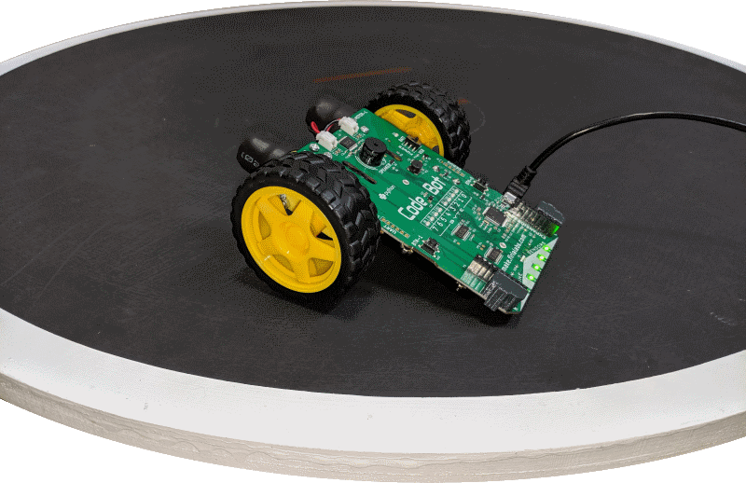
Mission 5: Fence Patrol
In this project, you will learn how to use data from CodeBot’s line sensors.
CodeBot has several sensors onboard.
The sensors allow CodeBot to interact with its environment.
Five of the sensors are line sensors.

Slide 4
Mission 5: Fence Patrol
The line sensors let Python code respond to changes as CodeBot moves across a surface.
The techniques you will learn in this project apply to all kinds of intelligent systems!

Slide 5
Mission 5: Fence Patrol
Think about what has driven CodeBot in the previous projects:
Your code used time with the sleep() function.
Your code did some sensing by detecting a button press.
You can still use these tools, but the sensors really expand your ‘bot’s abilities.

Slide 6
Mission 5: Fence Patrol
Project goals:
Read the line sensor and display the results on the green LEDs above them.
Use analog readings to measure the contrast between different surfaces.
Make a contact counter to show each line detect on the red User LEDs.
Teach CodeBot to drive tween the lines!

Slide 7
Mission 5: Fence Patrol
For this lesson, we will work on the first task:
Read the line sensor and display the results on the green LEDs above them.

Slide 8
Mission 5 Introduction Activity
DO THIS:
Answer the questions in your Lesson 1 log.
How many line sensors does CodeBot have?
What has driven CodeBot in previous projects?
This mission has four project goals. Which one interested you the most?

Slide 9
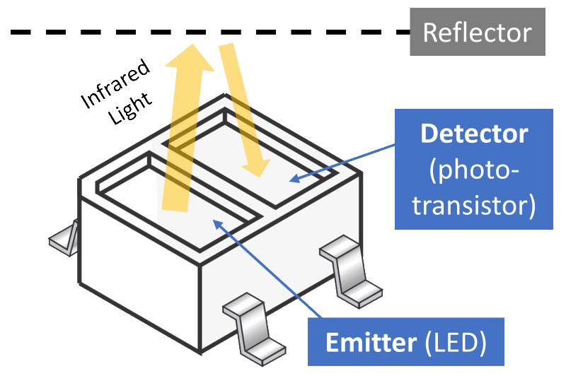
Objective #1: Line Sensors Up-Close!
How do the line sensors work?
The emitter is like a flashlight, shining invisible light.
The detector is like your eyes, judging how bright the reflection is.
The reflector could be anything! A taped line on the floor, or any object placed near the detector.

Slide 10
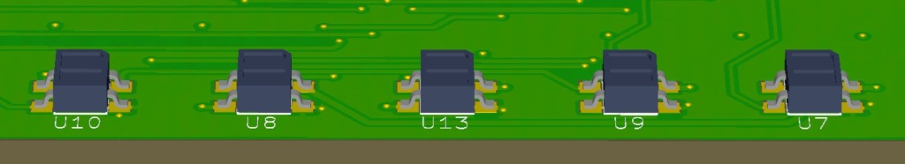
Objective #1: Line Sensors Up-Close!
The detected brightness level can vary based on:
Reflectivity of the surface.
  Reflective – shiny surfaces, white or light colors
  Non-reflective – black or dark colors, empty space
Distance of the surface from the sensor.

Slide 11
Objective #1: Line Sensors Up-Close!
Concept: API
Application Programming Interface
APIs enable different services to communicate.
APIs give details on how to interact with different services it needs.
  Turning on and using motors
  Pausing code execution (sleep)
  Reading data from the line sensors

Slide 12

Objective #1: Line Sensors Up-Close!
Analog data
The brightness level of reflected infrared light is measured with an analog value.
Analog means infinite variation.
  From dark to light
  From cold to hot
  From silent to very loud

Slide 13
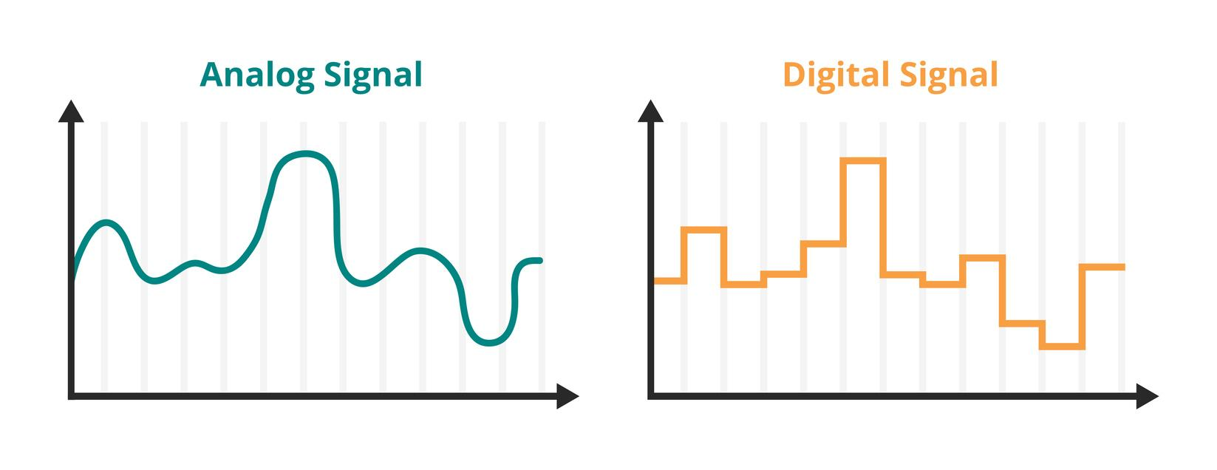
Analog Data:
Smooth and continuous signals that represent a quantity, like brightness.

Slide 14
Digital Data
A numerical representation of an analog signal, represented in increments.

Slide 15
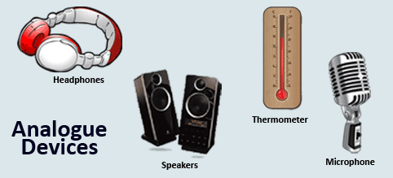
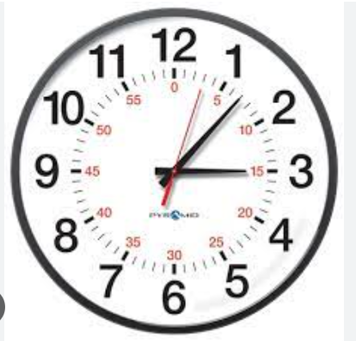
Analog devices:

Slide 16
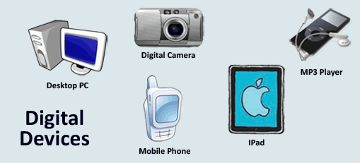
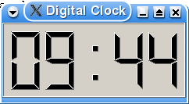
Digital devices:

Slide 17
Analog to Digital Conversion
What if you want a computer to measure something, like temperature or reflective light?
A digital computer can’t handle an infinite number of temperatures or light levels.
So it converts analog measurements to just a few digits, based on increments.
Fortunately the digital approximation of analog measurements is perfectly fine for many applications.

Slide 18
Analog to Digital Conversion
For example:
CodeBot’s line sensors emit IR light and then read the reflective light (analog). It converts the data to an integer between 0 and 4,095 (digital)
The analog-to-digital converter (ADC) has 12 bits resolution.
  2¹² = 4096

Slide 19
Objective #1: Line Sensors Up-Close!
You can read the brightness level of reflected light with this function:
ls.read(num) # Sensor 'num' can be 0, 1, 2, 3 or 4
The function reads an analog value, then converts it to an integer between 0 and 4095.

Slide 20
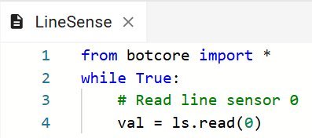
Objective #1 Activity
DO THIS:
Start a new file – LineSense
Type in this code:

Slide 21

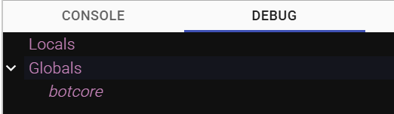
Objective #1 Activity
DO THIS:
Debug the program:
  Click the b button to open the console panel.
  Enter Debug mode.
Click on the “Debug” window, and open the “Globals” dropdown.

Slide 22

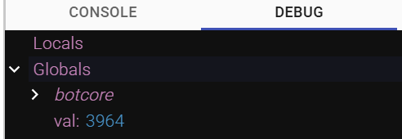
Objective #1 Activity
DO THIS:
Step through the code.
  Use the debugger Step In button
Step through the program several times.
Each time you click through a loop, try a different surface, or distance.

Slide 23
Objective #2: The Debug Console
It is great to use the debugger to inspect variables.
But there has to be a better way than stepping through the code continually.
Wouldn’t it be nicer to continuously display sensor data to a screen?
The console panel can be used for a lot more than debugging!

Slide 24
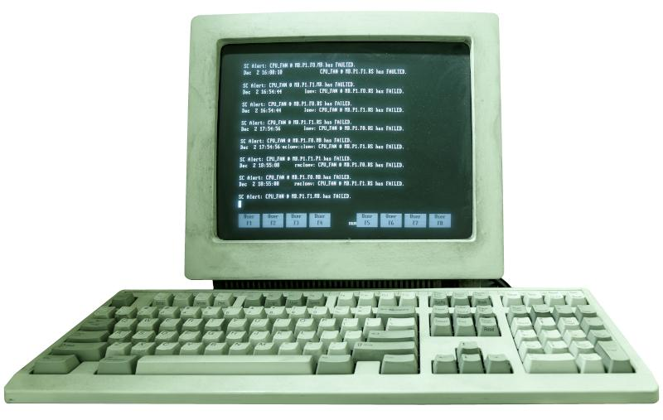
Objective #2: The Debug Console
You can print directly to the console panel.
The print() function displays a text message on the console panel.
To display the value of a variable, use it as an argument to the print() command.
print(val)

Slide 25
Objective #2: The Debug Console
You can add a description to the value with text in “quotes”.
Example:
print("Line sensor value = ", val)

Slide 26
Objective #2 Activity
DO THIS:
Print line sensor data to the console.
Import sleep from the time module.
Add a print statement to your code.
Slow down the reading by adding a sleep()

Slide 27
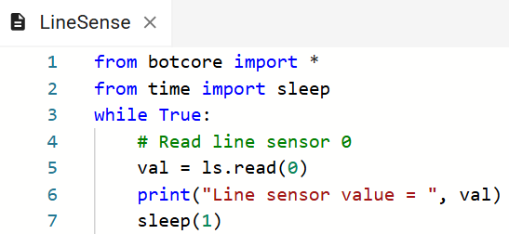
Objective #2 Activity
DO THIS:

Slide 28
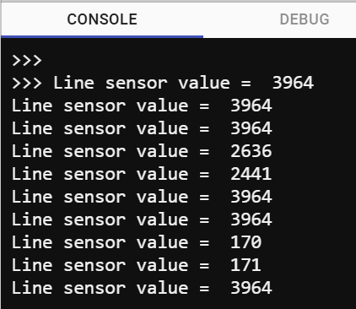
Objective #2 Activity
DO THIS:
Open the console panel.
Click on the “console” window.
Run the code. Use different surfaces under the line sensors.
Observe the data
displayed on the
console.

Slide 29
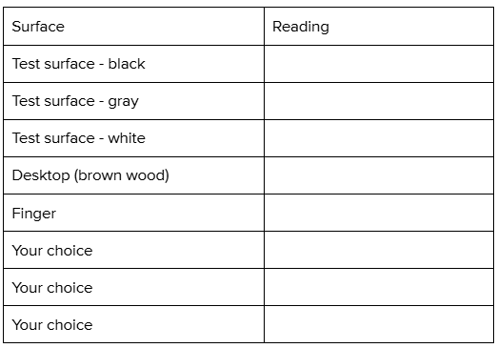
Objective #2 Activity
DO THIS:
Fill out the chart on your mission log.

Slide 30
Post-Mission Reflection
Complete the post-mission reflection in your Mission 5 Lesson 1 Log:
What possible values are returned when reading a line sensor?
What are some uses for line sensors?

